Slide 1
Deep Learning Course
Majid Nasiri Manjili
Shahid Rajaee Teacher Training University

Slide 2
Introduce
Majid Nasiri
B.sc : Electronic (Shiraz University of Technology)
M.sc: Artificial Intelegence (Shahid Rajaee Teacher Training University)
Email: mail.ai@yahoo.com
Web: https://github.com/m-nasiri

Slide 3
Topics
Convolutional Network Components
Training Network
Regularization
MNIST CNN project

Slide 4
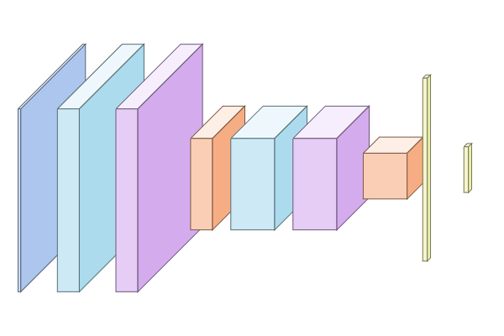
first layer
second layer
input layer
output
pooling
softmax
conv
non-linearity
pooling
fully-connected
conv
non-linearity
https://codebox.net/convnetdesigner/main.html

Slide 5

Convolutional Layer (filters, biasses, convolution)
https://github.com/vdumoulin/conv_arithmetic

Slide 6

Convolutional Layer (filters, biasses, convolution)
W : input size
F: filter size
P: padding
S: stride
Feature map size = (W-F+2*P)/S + 1
= (5-3+2*1)/1 + 1
= 4 + 1 = 5
Feature map size = (W-F+2*P)/S + 1
= (5-3+2*1)/2 + 1
= 2 + 1 = 3
https://github.com/vdumoulin/conv_arithmetic

Slide 7
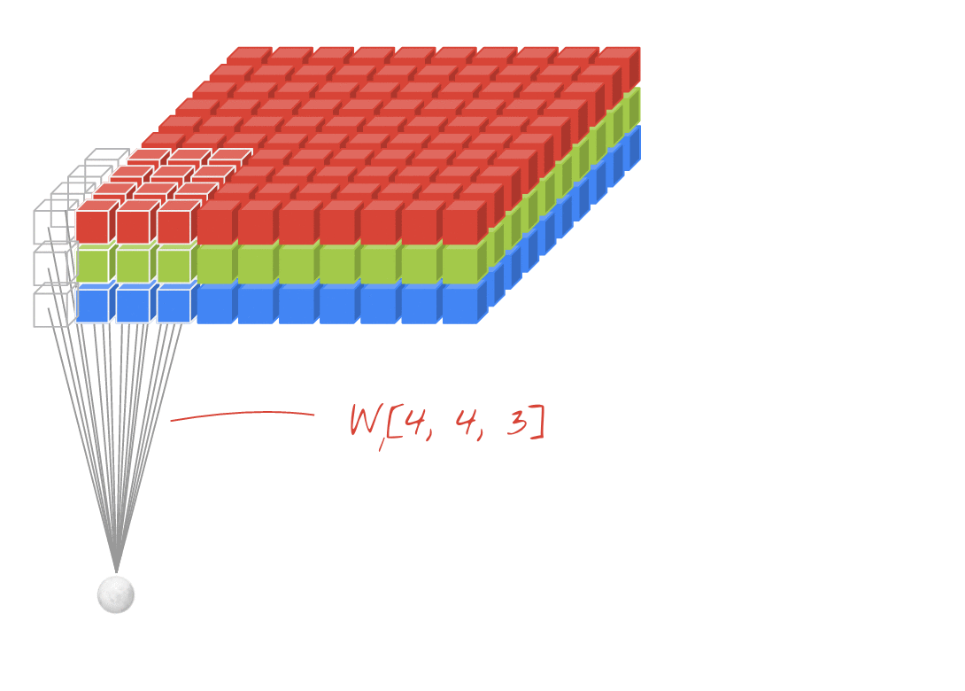
Convolutional Layer

Slide 8

Non-linearity

Slide 9
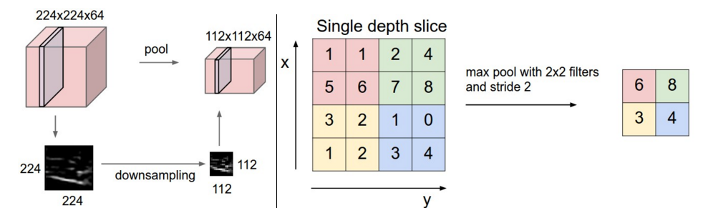
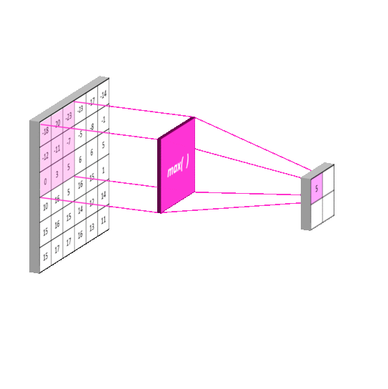
Pooling Layer

Slide 10
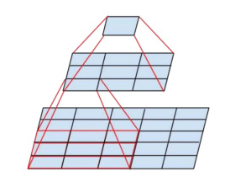
Receptive field

Slide 11
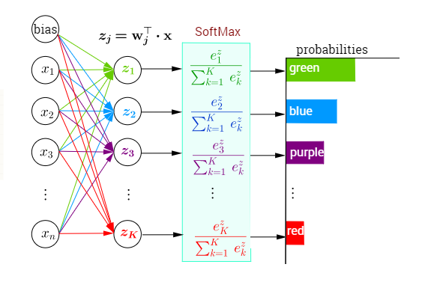
Softmax
Logit to probability
Larger loss

Slide 12
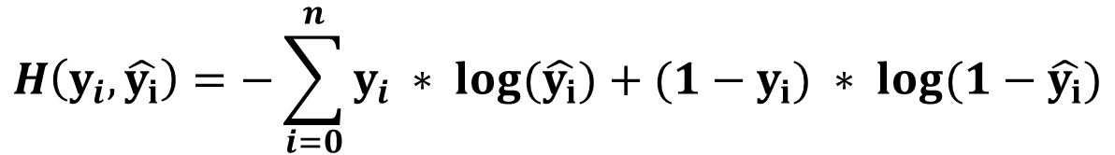
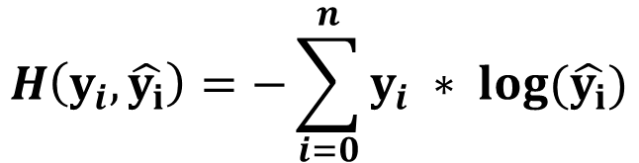
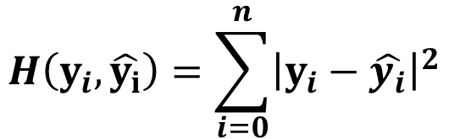
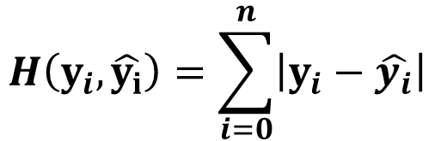
Loss function
$$H\left(y_{i},\hat{y_{i}}\right)=\sum_{i=0}^{n}{\left|y_{i}−\hat{y_{i}}\right|}$$
L1 Loss
L2 Loss (Mean squared Error)
Cross Entropy Loss
$$H\left(y_{i},\hat{y_{i}}\right)=\sum_{i=0}^{n}{{\left|y_{i}−\hat{y_{i}}\right|}^{2}}$$
$$H\left(y_{i},\hat{y_{i}}\right)=−\sum_{i=0}^{n}{y_{i} ∗ \log{(\hat{y_{i}})}}$$
$$H\left(y_{i},\hat{y_{i}}\right)=−\sum_{i=0}^{n}{y_{i} ∗ \log{(\hat{y_{i}})}+(1−y_{i}) ∗ \log{(1−\hat{y_{i}})}}$$

Slide 13
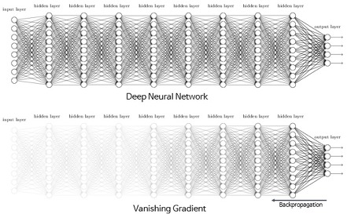
Vanishing/Exploding gradient
Relu
Identity

Slide 14
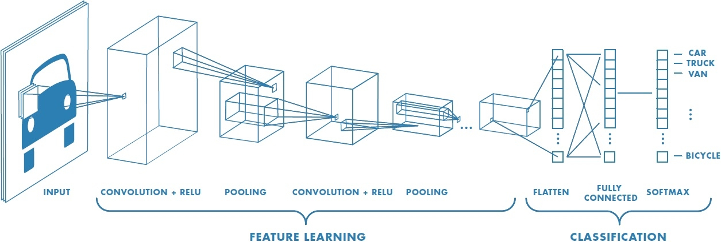
Convolutional Network for Image Classification

Slide 15
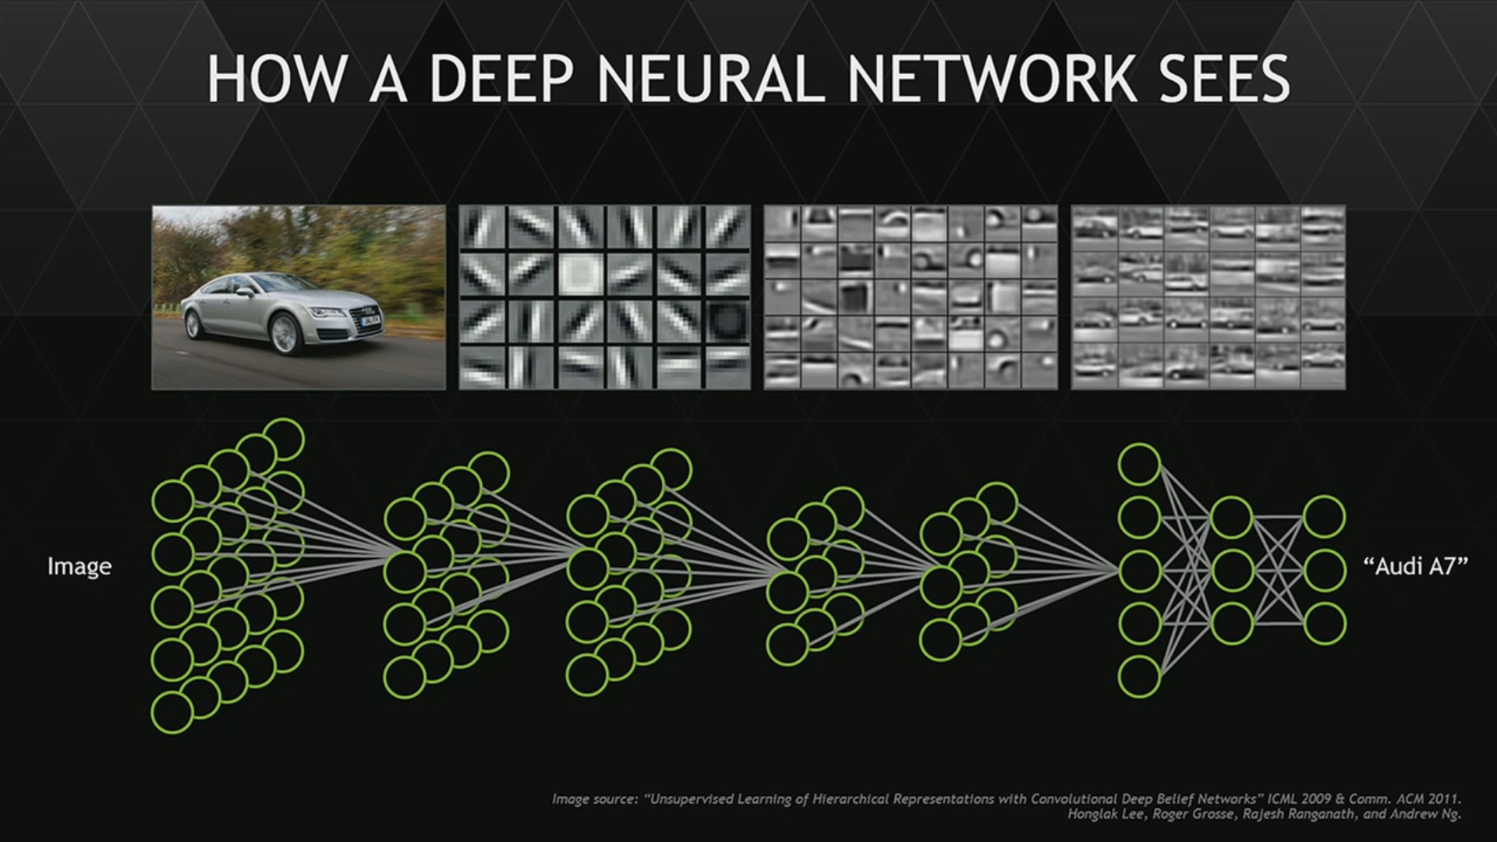
Convolutional Network for Image Classification

Slide 16
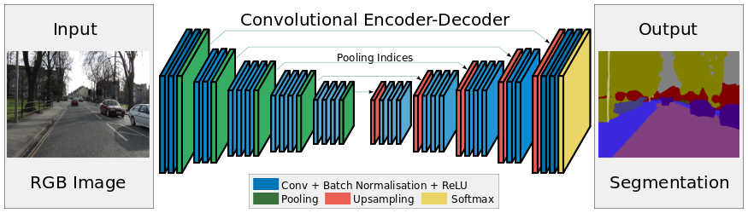
Convolutional Neural Network for Image Segmentation

Slide 17

Deconvolution Layer
Deconvolution

Slide 18


Vanila Convolution & Dialated conv & Deconvolution
vanila conv
dialated conv
atrous conv
deconvolution
transposed conv
upconv
strided conv

Slide 19
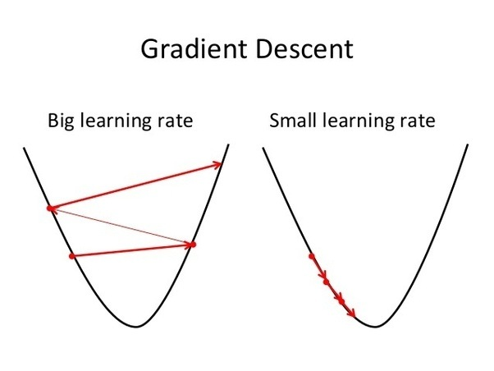
Training Network learning rate
Network size Vs Learning Rate
Batch size Vs Learning Rate
Dynamic Learning Rate

Slide 20
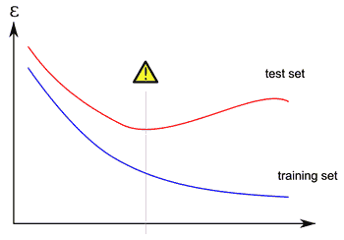
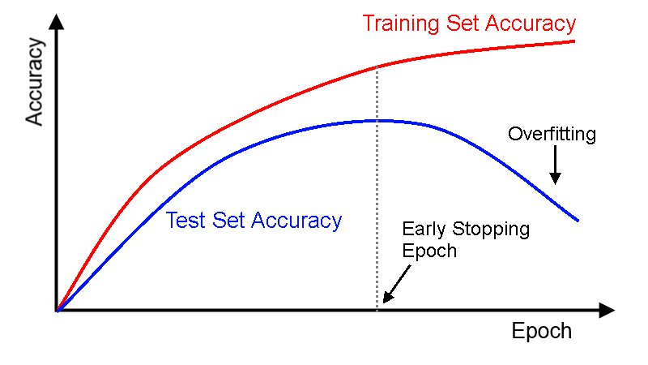
Training Network train & test

Slide 21
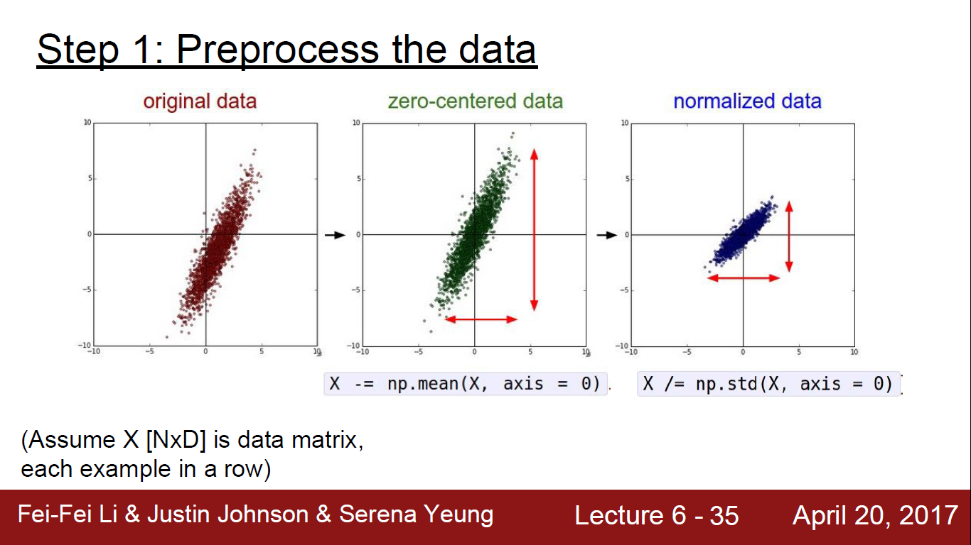

Slide 22
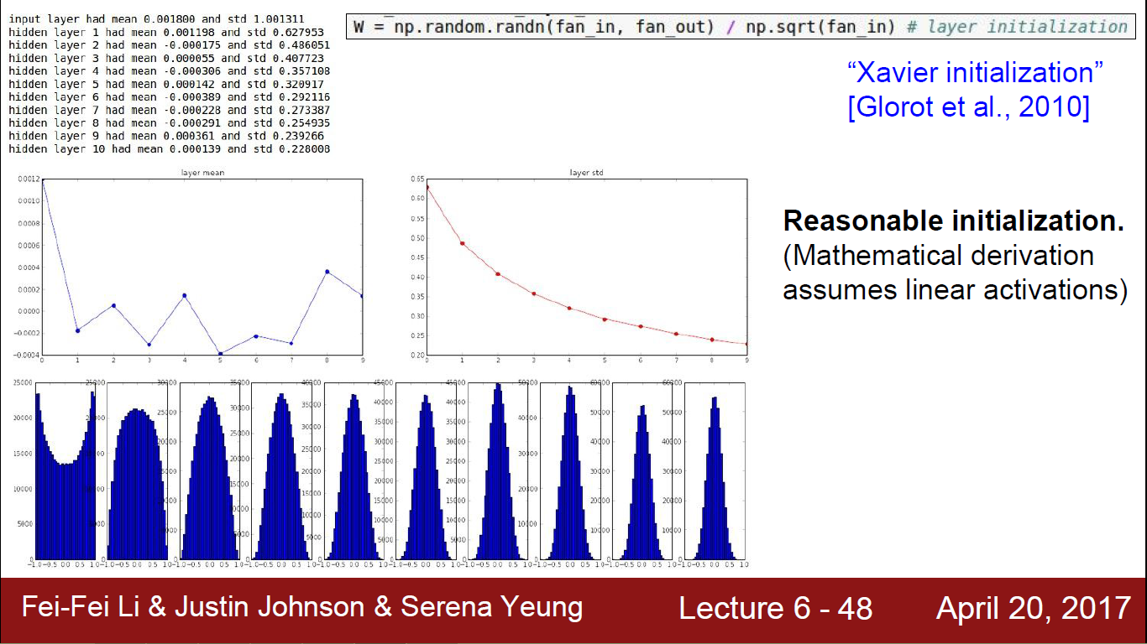
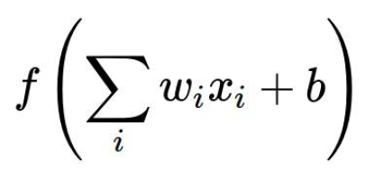
Weight Initialization
Zero-mean
Network size & initialization
All positive inputs

Slide 23
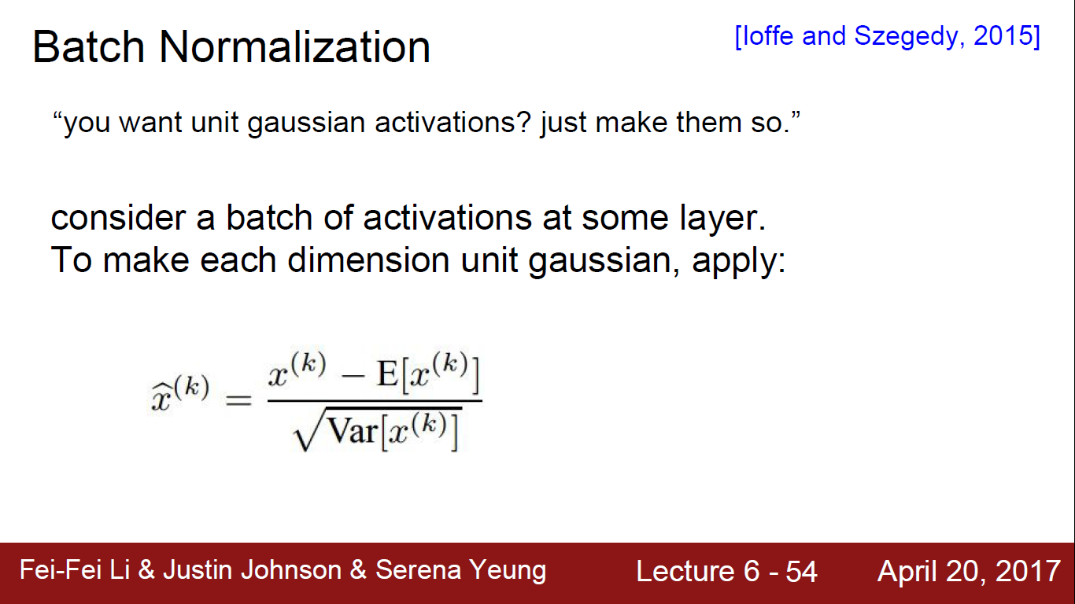
Usually After Fully-Connected or Convolutional Layers

Slide 24
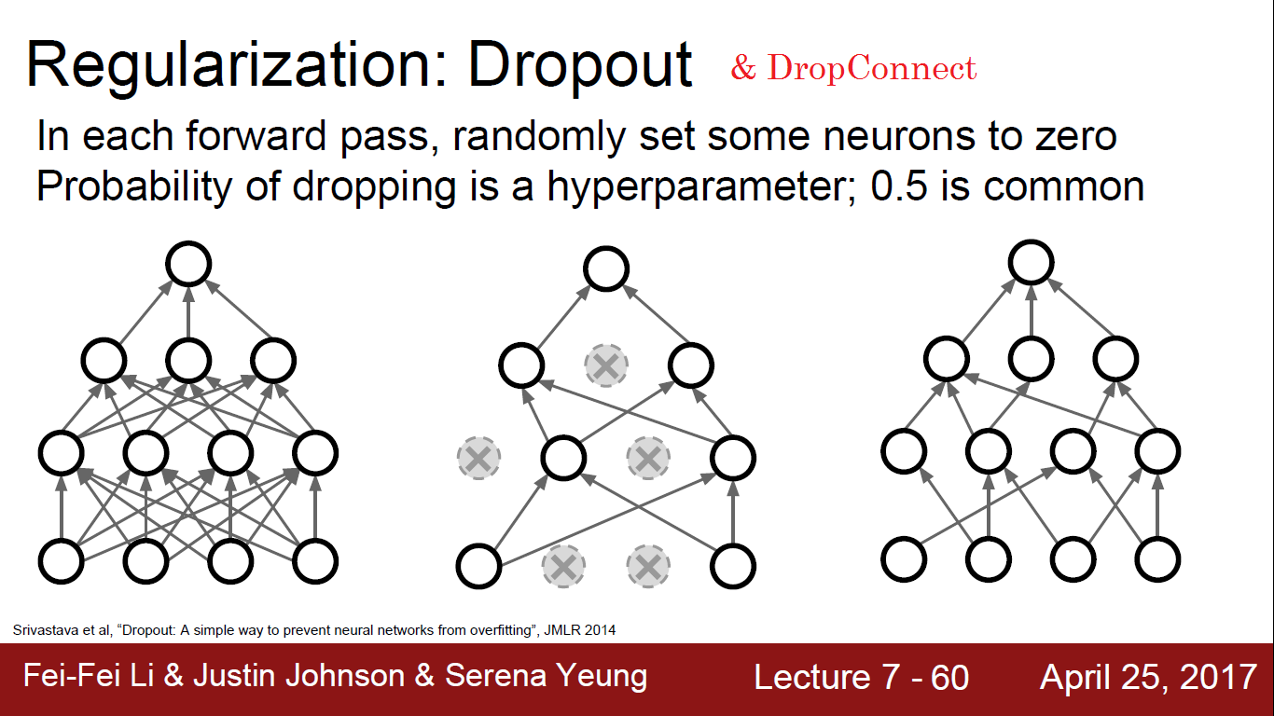

Slide 25
Training Network Dropout points
Learn more robust features
Doubles the number of epochs
More parameters more regularization
Fully-Connected layers need more dropout than Convolutional layers

Slide 26
Regularization Data Augmentation
Random crop, flip
Random (translation, rotation, stretching, ...)
Change Brightness
Resize image
Add random noise

Slide 27
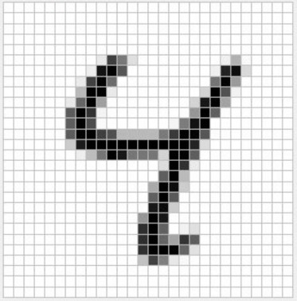
Convolutional Network for mnist dataset
X
Y
x1 | y1
x2 | y2
... | ...
xN | yN
0 | 0 | 0 | 1 | 0 | 0 | 0 | 0 | 0 | 0

Slide 28
Convolutional Network for mnist dataset
[1 28 28 1]
weights = [120 10]
fc= [1 120]
relu= [1 10]
weights = [3 3 8] * 12
conv = [1 14 14 12]
relu = [1 14 14 12]
pool = [1 7 7 12]
weights= [588 120]
fc= [1 588]
relu= [1 120]
weights = [3 3 1] * 8
conv = [1 28 28 8]
relu = [1 28 28 8]
pool = [1 14 14 8]

